Slide 1

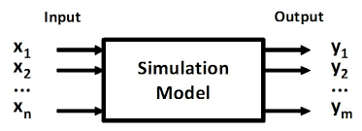
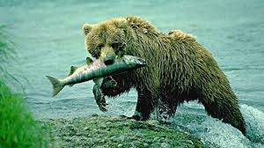
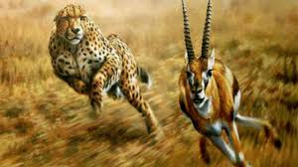
Lab 2: Simulating Predator-Prey Relationships
BSEN 6250

Slide 2
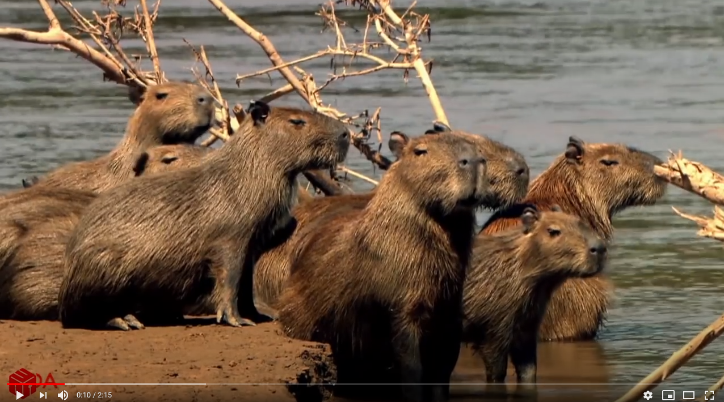
Capybara vs Jaguar in Brazil
Play Video: Lab 2-Capybara vs Jaguar.mp4 (Time: 2:30)

Slide 3
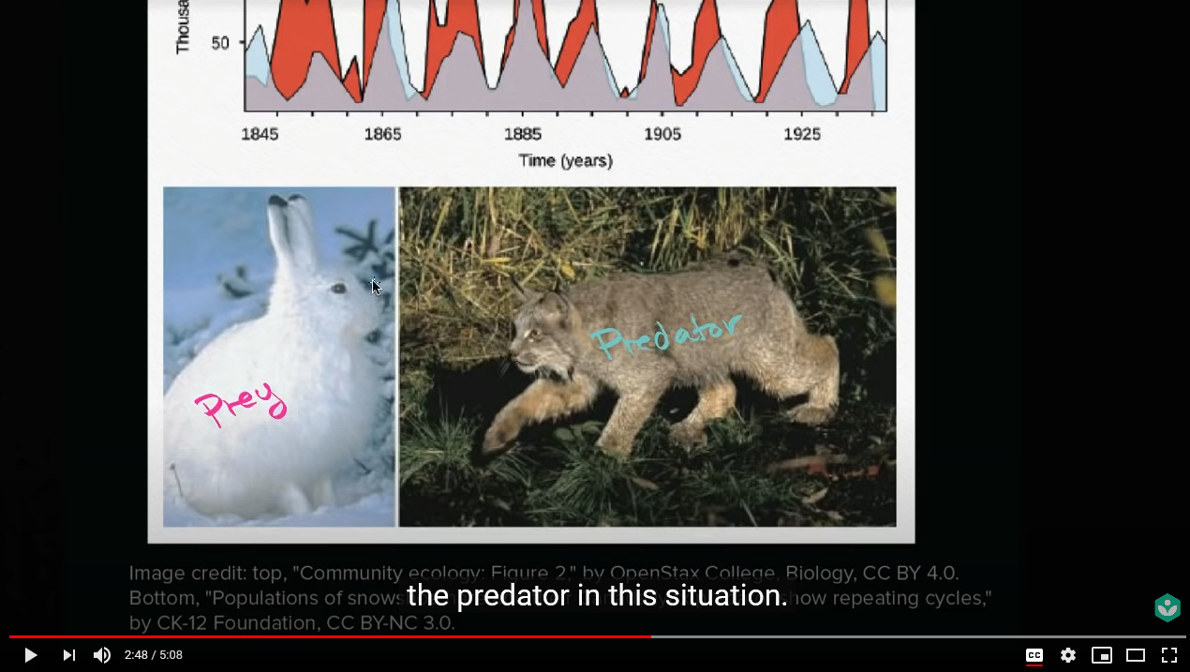
Predator-Prey Cycle
Play Video: Lab 2- Predator Prey Cycle Ecology.mp4 (Time: 5:20)

Slide 4
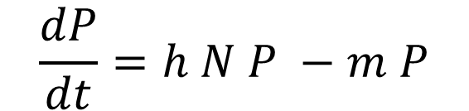
Lotka-Volterra Model of Predation (1926)
Prey Equation
Predator Equation
$$\frac{dP}{dt}=h N P −m P$$
Population Decrease
Population Increase
N = population of prey, #
τ = growth rate at minimum pop, 1/time
g = efficiency of predation
P = population of predator, #
h = capture rate and conversion of prey into predators, 1/no.-time
m = predator death rate as a function of prey population, 1/time

Slide 5

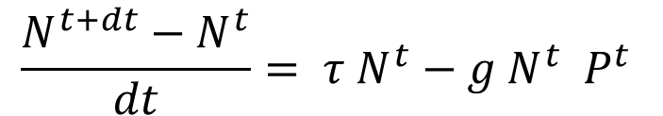
Euler Integration of Prey Equation
Prey Equation
N^{t+dt}
N^{t}
$$\frac{N^{t+dt}−N^{t}}{dt}= τ N^{t}−g N^{t} P^{t}$$
dt
= Current State of System
$$N^{t+dt}=N^{t}+\left( τ N^{t} −g N^{t} P^{t} \right)dt$$
Use state of the system (N^{t} and P^{t}) at time t to estimate state of system (N^{t+dt}) at time t+dt

Slide 6
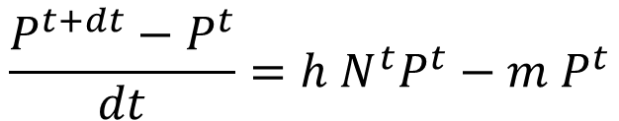
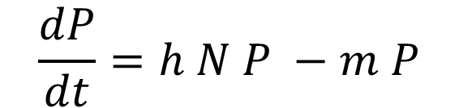
Euler Integration of Predator Equation
Predator Equation
$$\frac{dP}{dt}=h N P −m P$$
P^{t+dt}
P^{t}
$$\frac{P^{t+dt}−P^{t}}{dt}=h N^{t}P^{t}−m P^{t}$$
dt
= Current State of System
$$P^{t+dt}=P^{t}+\left( h N^{t}P^{t} −m P^{t} \right)dt$$
Use state of the system (N^{t} and P^{t}) at time t to estimate state of system (P^{t+dt}) at time t+dt

Slide 7
Lotka-Volterra Model of Predation (1926)
Solution requires solving both equations simultaneously for each time step
$$N^{t+dt}=N^{t}+\left( Ƭ N^{t} −g N^{t} P^{t} \right)dt$$
$$P^{t+dt}=P^{t}+\left( h N^{t}P^{t} −m P^{t} \right)dt$$
Solution is very unstable with large timesteps

Slide 10
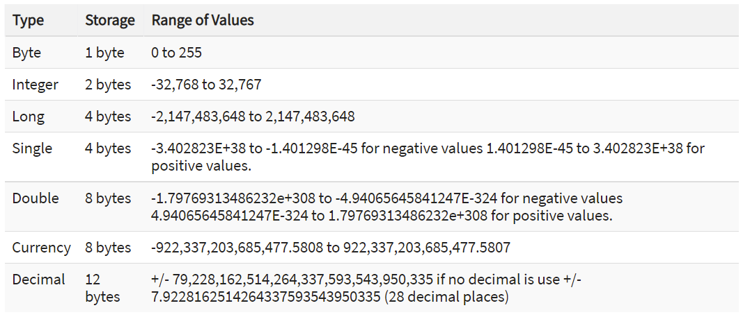
VBA Principles-Dimensioning Variables
Dimension all variables using the DIM command
Dim x, y, z as Double

Slide 11
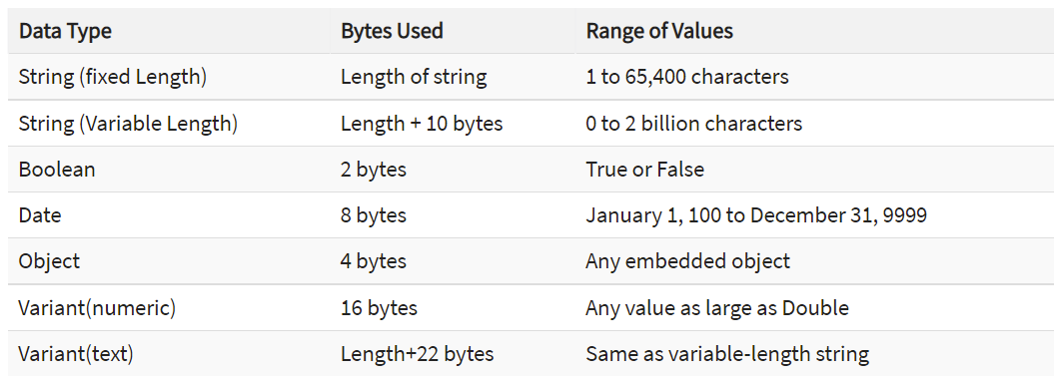
VBA Principles-Dimensioning Variables
Dimension all variables using the DIM command
Dim x, y, z as Integer
Dim Name as String

Slide 12
VBA Principles
Add comments in the code using apostrophe ‘my comment
Use comments to define sections of the code
Add variable list at beginning or end of code
Indent lines of code between For and Next statements
Initialize all variables!

Slide 13
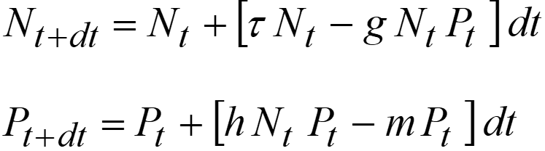
VBA Loops
‘Set initial conditions at time t=0
LastP = P
LastN = N
Always initialize variables.
For time = dt To Duration Step dt
N = LastN + (r*LastN – g * LastN * LastP) * dt
P = LastP + (h*LastN*LastP – m*LastP) * dt
LastN = N
LastP = P
check for new max and min values
Next time
Note: the variable time will be increased by the value of dt each cycle through the For-Next loop. Thus, Time = 1, 2, 3, 4, 5… Duration

Slide 14
Max and Min Tracking Variables
Create variables for maximum and minimum populations
Set initial Min variable values to a very high number
Set initial Max variable values to a very low number
Check for new Max and Min values inside time step loop
‘Initialize Max and Min variables
MaxN = -99
MaxP = -99
MinN = 99999
MinP = 99999

Slide 15
Max and Min Tracking Variables
For time = dt To Duration Step dt
N = …
P = …
if N > MaxN then MaxN = N
if N < MinN then MinN = N
if P > MaxP then MaxP = P
if P < MinP then MinP = P
Next time

Slide 16
Write Output to Excel
Timestep is 0.01 years but Duration of Simulation is 250 years
Write annual output to Excel (not every timestep)
Requires a counter to count from 0.0 to 1.0 by dt
For time = dt To Duration Step dt
‘Update state variables each time step
'Determine when next whole year occurs and write output to spreadsheet
Count = Count + 1
If Count = 100 Then
Row = Row + 1
Range("Output").Cells(Row, 1).Value = time
Range("Output").Cells(Row, 2).Value = N
Range("Output").Cells(Row, 3).Value = P
Count = 0
End If
Next time

Slide 17
Using Models to Study System Behavior
Conduct a sensitivity analysis on predation efficiency (g) on predator and prey population dynamics
Vary the value of g from 0.001 – 0.011 in increments of 0.002 and discuss impacts on population dynamics
Use the model to develop new insights into the system behavior, or to analyze the impact of change to system behavior

Slide 18
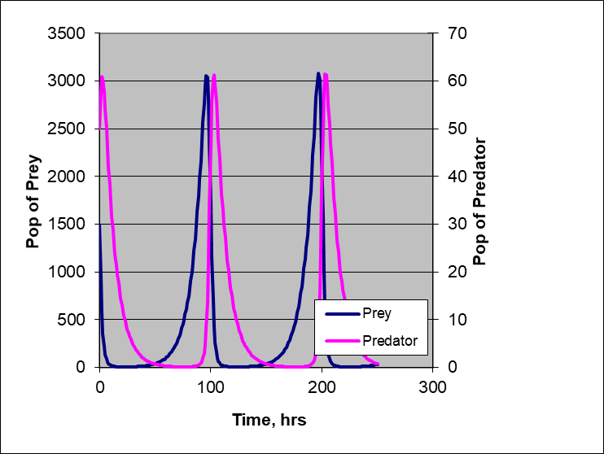
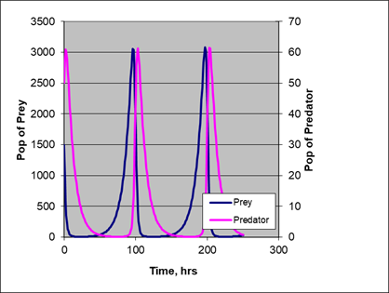
Student’s Typical Lab Work

Slide 19
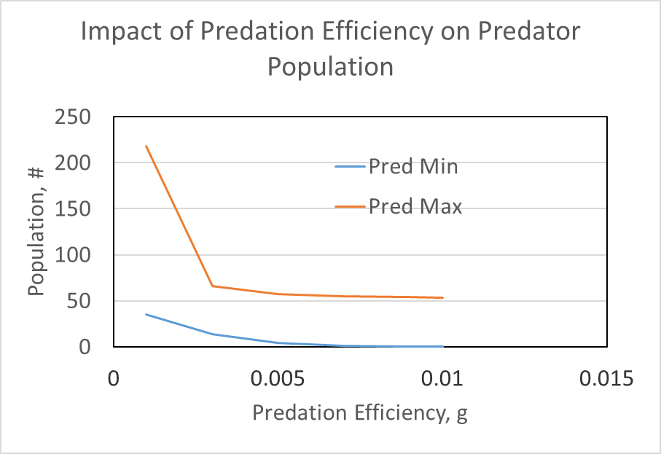
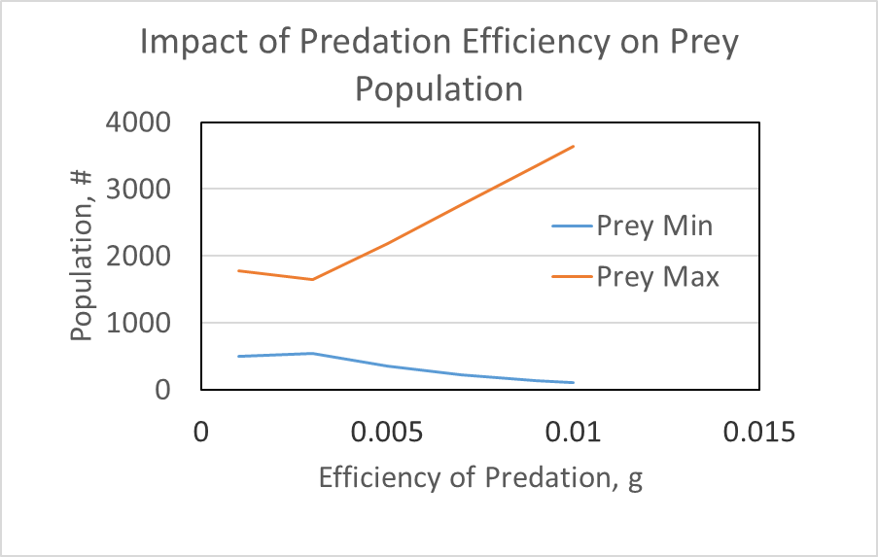
Conveying Information Through Graphs

Slide 20
Conveying Information Through Graphs
Think about the information you are trying to convey to the reader
Develop innovative graphs that convey information in a concise way
Do not expect reader to pick out information from numerous graphs and tables
Real measured data is show with a symbol, where model results are shown as lines (no symbols)
Do not let Microsoft choose what your graph looks like (fonts, color, linestyles, etc)

